Slide 1
Legendary Legend Stars
Rehearsal Framework, Strategies,
and Storytelling
Raul Dominguez, DMA (he/him)
Pacific Lutheran University
Raulconducts.com

Slide 2


Legendary Legend Stars

Slide 3
Background
Background
Why?

Slide 4
Rehearsal Framework

Slide 5
Know Your Why’s
Purpose vs. Mission
Purpose
Mission

Slide 6
Strengths
Best aspects of your program
What would you show off?

Slide 7
Toleration
“Get away with”
What would you hide?

Slide 8
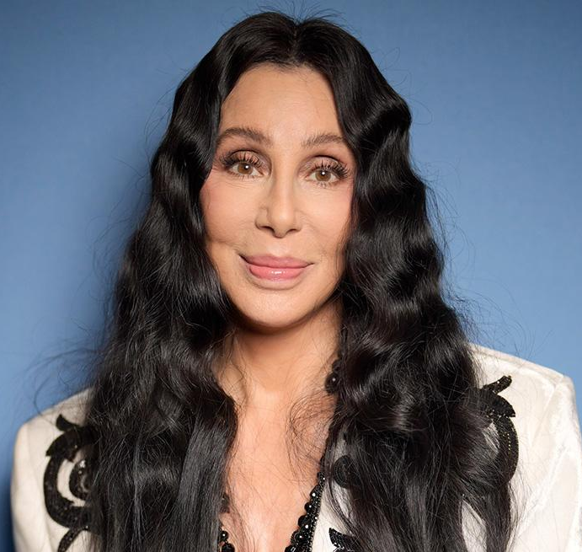
Time to Cher!
Why
  Purpose
  Mission
Strengths
Toleration

Slide 9
Strategies

Slide 10
Rehearsal Goals and Order
Broad
Specific
Familiar Sandwich

Slide 11
Preparing Your Rehearsal
Score elements and form
Text Work
Learn the piece
Sound world

Slide 12
Rhythm
Feel
Metronome
Physical Pulse
Count Singing

Slide 13
Adding Pitch
Reading down-tempo
Neutral syllables or solfege
Rote teaching

Slide 14
Technique
Voice philosophy statement
Warm up informed by repertoire
Repertoire that nurtures vocal development

Slide 15
Expression
Teaching “feel”
Movement
Sensitizing ensemble to gesture
Parallels: Technique and Expression

Slide 16
Own Your Tone
Three levels of “ew”
The B word vs. Vowel matching
IPA or phonetic sounds in score

Slide 17

Time to Cher!
Strategies
  Goals
  Preparation
  Rhythm
  Pitch
  Technique
  Expression
  Tone

Slide 18
Storytelling

Slide 19
Why It Matters
Humanity’s stories
Lived experiences through repertoire

Slide 20
Planning Your Concert
Theme and title
Repertoire
Storytelling elements

Slide 21
Diversity and Flow
Repertoire reflects different stories
Programmatic Flow

Slide 22
Regis University Singers - Sueños
Sing Out, My Soul, Marques L. A. Garrett
Stars I Shall Find, Victor C. Johnson
Mar de Sueños, Diana Syrse
Hands, Kevin T. Padworski
I Dream a World, André J. Thomas
Let the River Run, arr. Craig Hella Johnson

Slide 23
PLU Chorale: It’s Not Too Late: Climate Mass
For the Beauty of the Earth,
John Rutter
3-4 mvts from Gartenlieder,
Fanny Hensel
Rivers of Living Water,
Trevor Watson
In Profundum Maris,
Richard Nance
Climate Mass, Loretta Notareschi
  Kyrie
  Gloria
  Sanctus
  Agnus Dei

Slide 24
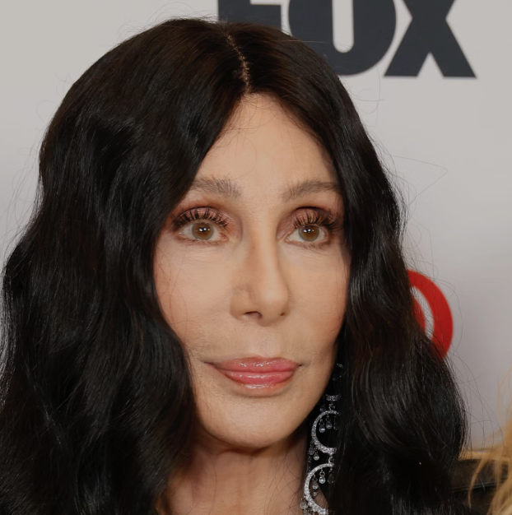

Time to Cher!
Brainstorm a theme and repertoire

Slide 25
Fostering Connection
Collaborating with other departments or classes
Other art mediums
Guests or culture bearers
Sharing student experiences around repertoire
Student-made memory boards

Slide 26
Thank you for coming!
Questions?
Raul Dominguez, DMA
domingr@plu.edu
raulconducts.com/presentations

