Slide 1


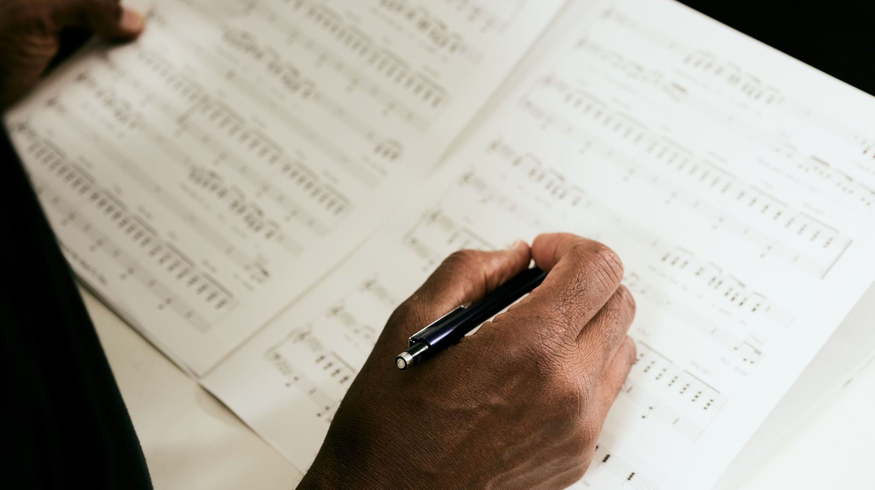
Choral Music and Storytelling:
Building Engagement Through Program Flow
Matthew Myers, DMA, Washington State University
Raul Dominguez, DMA, Regis University

Slide 2
Why Storytelling Matters
Telling humanity’s stories
Our lived experiences in repertoire
Abandoning the cookie-cutter concert
Opportunity to discover new-to-you repertoire

Slide 3
PLANNING YOUR CONCERT
Theme
Concert Title
Repertoire
Storytelling Elements

Slide 4
REGIS UNIVERSITY SINGERS
SUEÑOS PROGRAM
Sing Out, My Soul, Marques L. A. Garrett
Stars I Shall Find, Victor C. Johnson
Mar de Sueños, Diana Syrse
Hands, Kevin T. Padworski
I Dream a World, André J. Thomas
Let the River Run, arr. Craig Hella Johnson

Slide 5
You Will Be Found
Mental Health Awareness Month CONCERT
CHORALE
He That Shall Endure from Elijah, Felix Mendelssohn
Learning to Breathe, Dale Trumbore
Lacrymosa from Requiem, W. A. Mozart
North, arr. George Chung
CHAMBER CHOIR
Why, Oh Why, Jerry Ulrich
Indodana, arr. Barrett/Schmitt
Please Stay, Jake Runestad
You Find Yourself Here, Dale Trumbore
Stand by Me, arr. Mac Huff
CHORALE
Ain’t No Grave Can Hold My Body Down,
arr. Caldwell/Ivory
Light of a Clear Blue Morning, arr. Craig Hella Johnson
CHORALE WITH HIGH SCHOOL CHOIR
I Am Light, arr. Darita Seth
You Will Be Found, arr. Mac Huff

Slide 6
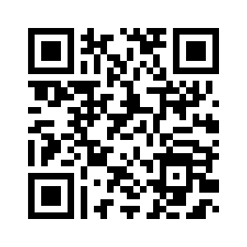
BUILD YOUR CONCERT
Break into small groups
Choose repertoire
for one of the following themes:
Water
Earth Day
Love
Night
Elements
Belonging
…or choose your own!
AIM FOR VARIETY:
Historical periods vs. contemporary
Composers of varied identities
Tempo
Instrumentation & voicing
etc.

Slide 7
THINGS
TO
CONSIDER
Theme and Concert title
Repertoire reflecting stories of:
Diverse roots
Gender identities/expressions
Different corners of the world
Flow
Tempo
Key
Thematic development

Slide 8

Flow Template
Opener
Novelty or unlike the “norm”
Unaccompanied heartfelt tune
Inspirational jam
Closer

Slide 9
WSU TREBLE CHOIR
NAfME Northwest 2023
Stars in Your Bones, Joan Szymko – opener energy
L’annonce, Marie-Claire Saindon – heartfelt accompanied tune, non-English
Refugee, Moira Smiley – novelty, body percussion
Stardust, B. E. Boykin – inspirational call to action
We Can Come Together (To Sing A Song), Alana Scott – a cappella heartfelt tune
The Year’s at the Spring, Amy Beach – closer energy

Slide 10
UNIVERSITY OF COLORADO TREBLE CHOIR
ONE VOICE
Pentatonic Alleluia, Ross Whitney – aleatoric, sets the scene (narration included)
The Stars are with the Voyagers, Eleanor Daley – heartfelt accompanied tune
The Silver Apples of the Moon, Gwyneth Walker – novelty, improvisation
Voice on the Wind, Sarah Quartel – unaccompanied call to action
One Voice, Ruth Moody, arr. Marcelline Moody – closer energy, inspirational jam

Slide 11
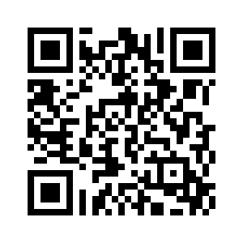
FIND YOUR FLOW
Break into same small groups
Return to your repertoire
Set the tunes
in an order that flows for you:
Opener
Novelty or unlike the “norm”
Unaccompanied heartfelt tune
Inspirational jam
Closer

Slide 12

Elements
Storyboard
Multimedia
Poetry/Narration
Staging
Performance Considerations

Slide 13
Connecting to the Music
Assignments or Projects
Connections to other art mediums
Guests

Slide 14

Social/ Emotional Learning
Class Discussions, Listening Circles
Retreat Activities
Post-Concert Talk Backs: Performers and Audience

Slide 15
Thank you for coming!
Raul Dominguez, DMA
Regis University
rdominguez@regis.edu
raulconducts.com
Matthew Myers, DMA
Washington State University
matthew.myers1@wsu.edu
choirfam.buzzsprout.com

