Slide 1
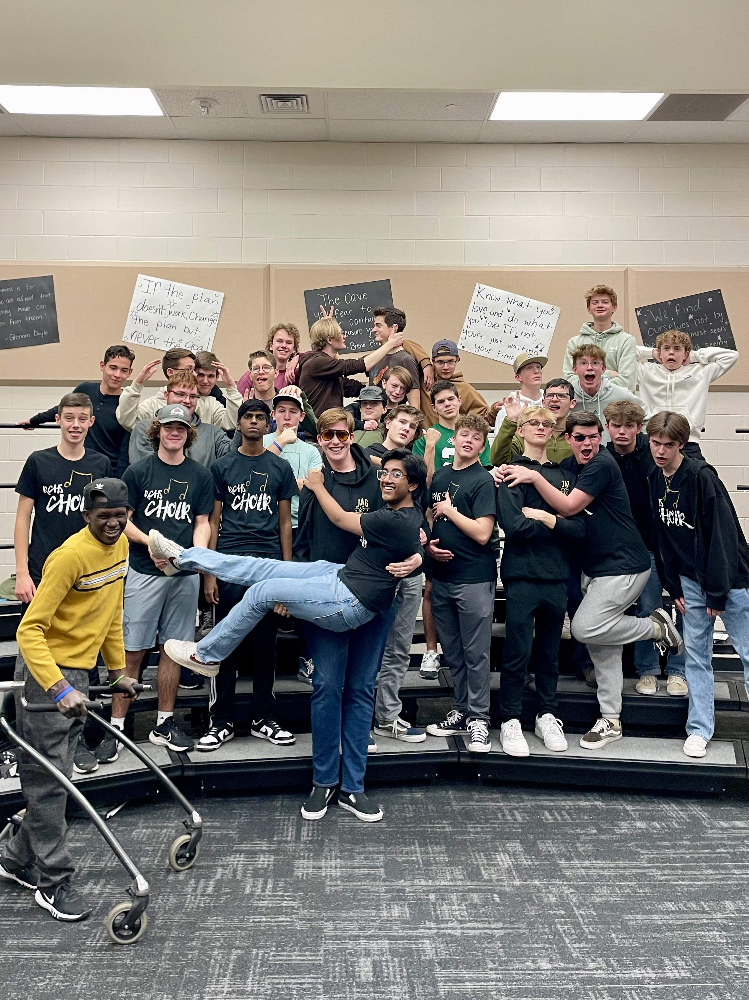
Voices, Meaning, and Rotisserie Chicken: Developing Tenor/Bass Singers
Raul Dominguez, DMA (he/him)
Regis University
Raulconducts.com
Julia Dale (she/her)
Rock Canyon HS
CMEA 2024

Slide 2
Introduction
Purpose and what to expect

Slide 3
Warm Up
Breath
Voice in all ranges
Outline
Exercises

Slide 4
Rehearsal
One Light, Evan Ramos
Sto Mi E Milo, arr. Daniel Hughes

Slide 5
Fostering Culture
Repertoire
Family Groups
Watching other concerts
Bonding activities
Students to demonstrate (treble octave displacement)

Slide 6
Testimonials and Recruitment
Why Choir / Best Memories
Recruitment
  They recruit each other
  Repertoire
  Elementary Schools
  Middle Schools
  Rotisserie chicken

Slide 7
Thank you for coming!
Raul Dominguez, DMA (he/him)
Regis University
rdominguez@regis.edu
Raulconducts.com
Julia Dale (she/her)
Rock Canyon HS
julia.dale@dcsdk12.org

